Slide 1



Local
Container
Input data
Like CLM input
inputfolder
$CESMDATAROOT/inputdata
Hist output data
Only land
outputfolder
$CESMDATAROOT/Archive/lnd/hist
Scripts
Bash scripts
Cases
scriptsfolder
/p/scripts
Log
Case log
Cases output
logfolder
$CESMDATAROOT/CaseOutputs

Slide 2



pyclmuapp
Pull image
Run container
Run case
Get results
Create forcing
Create surface
…
CLMU-App
CLM ENV
CLM >
(hosted by NCAR)
GitHub: https://github.com/ESCOMP/CTSM
Run CLM/CTSM in container
CLMU
./create_case …
./xmlchange …
…
./case.build
./preview_namelists
./case.submit
Linux
Mac
Win
AMD
64
ARM
64

Slide 3
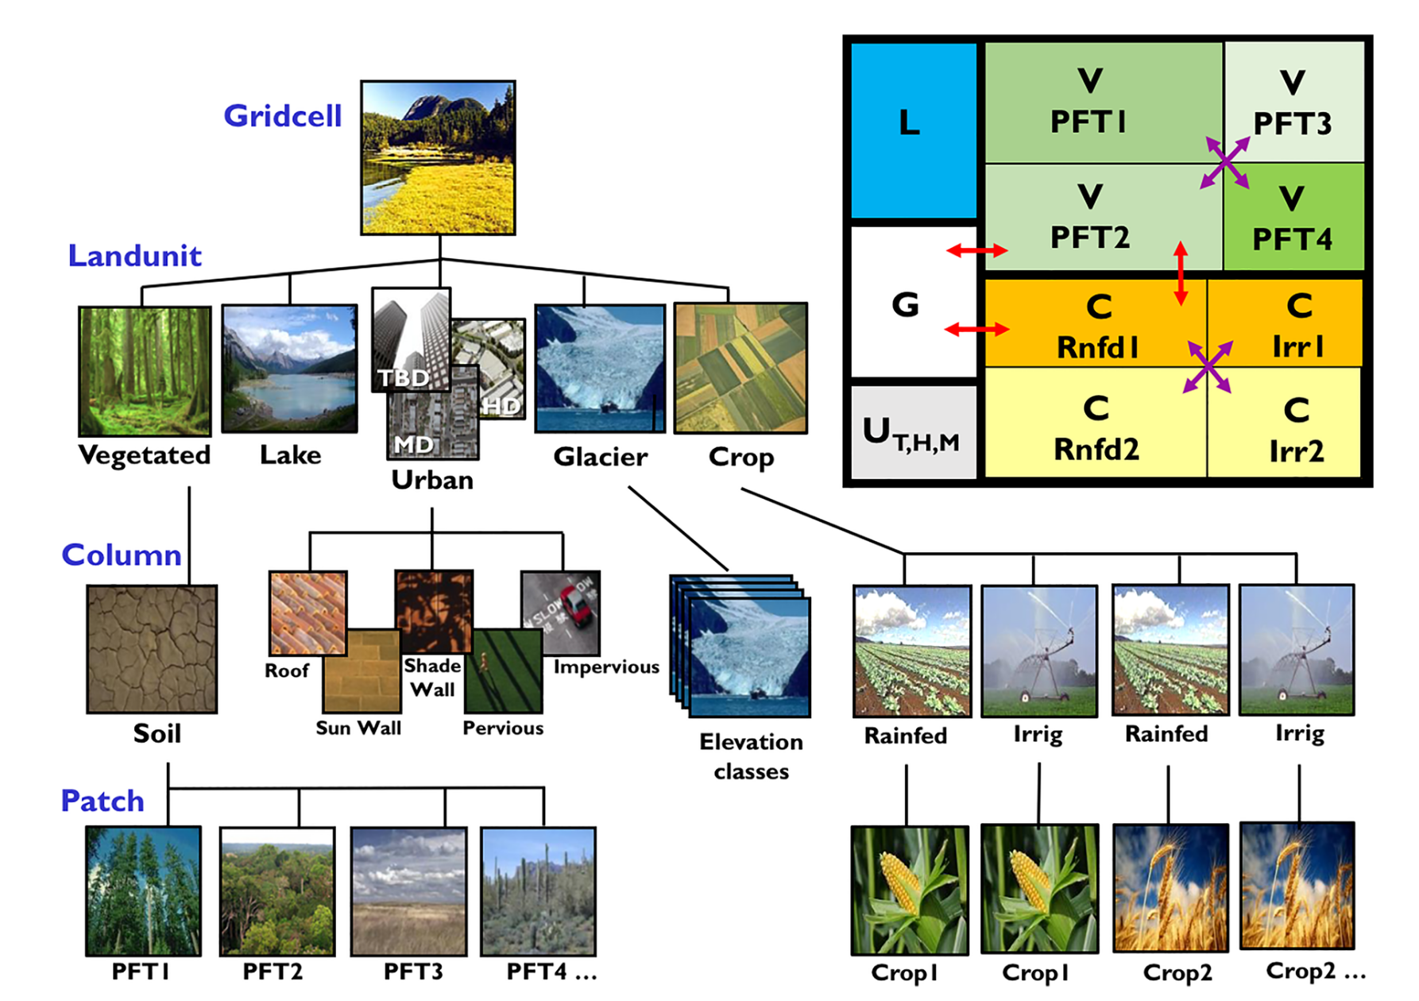


Slide 4

Cell grid
Land model component
ESM Component
Soil
Hydrology
…
Urban
…
ATM
LND
OCN
ICE
…
lat
lon
ESM
Radiation
Surface energy
Building energy
Hydrology
roof
wall
roof
pervious road
impervious road
Urban canyon

